Slide 1


HARDWARE ARCHITECTURES FOR DEEP LEARNING MODELS
Presenters:
1. Towhidul Islam – 202381732 (FPGA)
2. Moni Kishore Dhar – 202380330 (ASIC)
3. Sachi Datta – 202387871 (GPU)
4. Rifat Bin Masud – 202387267 (SiLaGO)
© ENGI-9819(Computer Hardware Found), 2023
www.mun.ca

Slide 2

HARDWARE ARCHITECTURES FOR DEEP LEARNING MODELS
Contents
Introduction!
Deep Learning
FPAGA
..
..
…
…
Career Development Services
© ENGI-9819(Computer Hardware Found), 2023
www.mun.ca

Slide 3
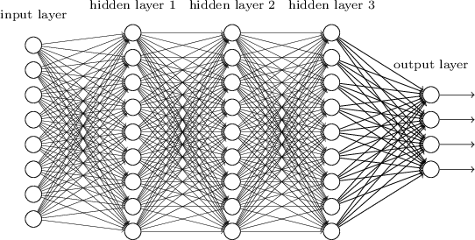
Deep Learning
A neural network is composed of multiple layers of nodes that receive input from other layers and produce an output until a final result is reached.
Example of DNN:
1. Convulational Nural Network
2. Artificial Neural Network
Consist of
1. Forward propagation
2. Backward propagation
© ENGI-9819(Computer Hardware Found), 2023
www.mun.ca

Slide 4
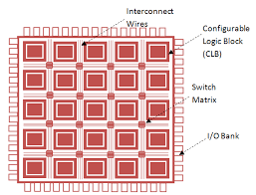
Field Programmable Gate Array (FPGA)
FPGA:
1. Integrated Circuit
2. Programmable or Reprogrammable
It consist of
1. Configurable Logic Block
2. Interconnects Wires
3. I/O
Used reasons:
1. Flexible
2. Faster
3. Parallel processing capabilities
© ENGI-9819(Computer Hardware Found), 2023
www.mun.ca
Notes:
A field-programmable gate array (FPGA) is a type of integrated circuit that can be programmed or reprogrammed after manufacturing. It consists of an array of programmable logic block and interconnects that can be configured to perform various digital functions. FPGAs are commonly used in applications where flexibility, speed, and parallel processing capabilities are required, such as in telecommunications, automotive, aerospace, and industrial sectors.

Slide 5
Reasons for FPGA in DL/DNN
• Design Benefits:
Can be designed in a more efficient way
Reconfigurable
Power consumption
Flexible
• Benefits Compare to GPU and CPU though they are faster in processing:
Faster in processing
Execute operation in few clock periods
Low Power consumption
Flexible
© ENGI-9819(Computer Hardware Found), 2023
www.mun.ca
Notes:
1) High performance with low energy:
2) High parallelism:FPGA’s editable logic hardware unit,we can easily optimize the hardware with the parallelizationalgorithm to achieve high parallelism.
3) Flexibility: Due to reconfigurability of FPGA its flexible to change in design.

Slide 6

Drawbacks
• Design Benefits:
Reconfigurable Cost
Programming Difficulties
© ENGI-9819(Computer Hardware Found), 2023
www.mun.ca
Notes:
1) Reconfigurable Cost:
2) Programming Difficulty:

Slide 7
Hardware Architectures!!
© INTERNATIONALIZATION OFFICE AND CAREER DEVELOPMENT (STUDENT LIFE), 2023
www.mun.ca

Slide 8
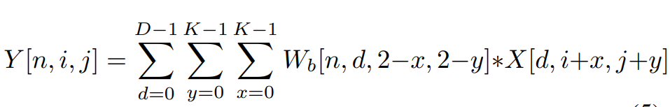
Deep Learning Binary Neural Network on an FPGA
• What is the paper about ?
• Equations it try to solve
• Problem Researcher try to solve
• Resource Used
- Hardware : Xilinx FPGA
- Dataset : CIFAR-10
© ENGI-9819(Computer Hardware Found), 2023
www.mun.ca
Notes:
What is the paper about ?
The paper presents the implementation of a binary neural network (BNN) on Xilinx FPGA for real-time object recognition.
Problem Researcher try to solve ?
->GPUs are not fit for embedded applications, because they are power hungry. As a result, many researchers investigated ways o implement deep neural networks on low power hardware[9], [10], [12]. This paper modifies binarized neural network to be hardwarecompatible and implements it on Xilinx FPGA. The system is targeted on Xilinx Zynq ZC706 and also on Virtex 7FPGA. It supports the rate of 60 framesper seconds.

Slide 9
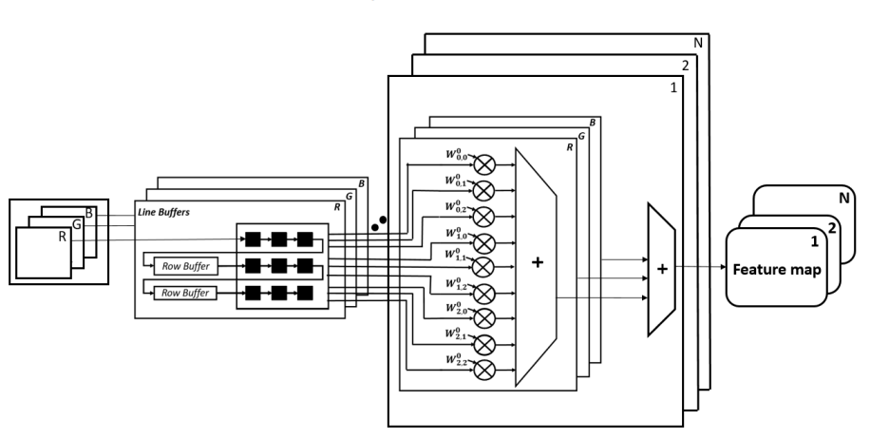
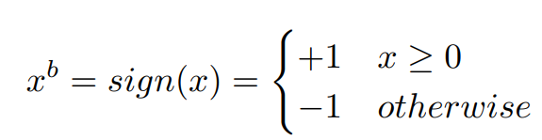
Deep Learning Binary Neural Network on an FPGA
• Pre-trained weights from training are binarized and Stored in BRAM
Figure : First Hidden layer
© ENGI-9819(Computer Hardware Found), 2023
www.mun.ca
Notes:
Pre-trained weights from training are binarized and Stored in BRAM:
It’s saved significat amount of memory because 8/16 bit data converted into 1 bit. For it memory usage reduced 8/16 times.

Slide 10
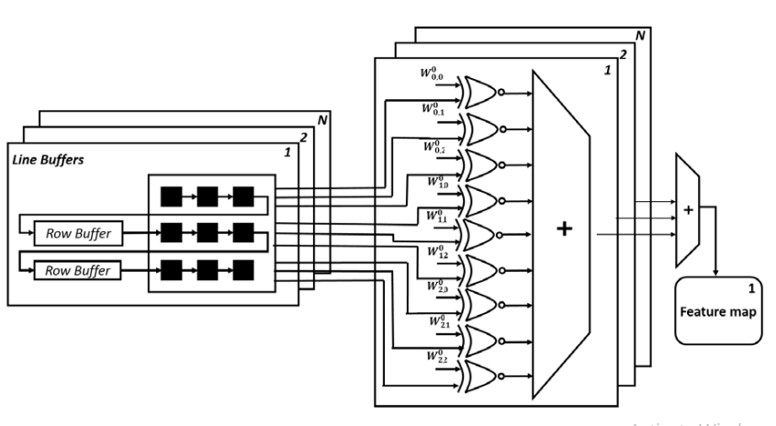
Deep Learning Binary Neural Network on an FPGA
Figure : The 2nd 3rd and 4th convolution layer
• Results
- Accuracy of 86.06% on CIFAR-10 dataset
maximum throughput of 332,158 images per second
-latency 4.9 µsec
© ENGI-9819(Computer Hardware Found), 2023
www.mun.ca
Notes:
Pre-trained weights from training are binarized and Stored in BRAM:
It’s saved significat amount of memory because 8/16 bit data converted into 1 bit. For it memory usage reduced 8/16 times.

Slide 11
A General Neural Network Hardware Architecture on FPGA
• What is the paper about ?
• Equations it try to solve
• Problem Researcher try to solve
• Resource Used
- Hardware : Xilinx FPGA
- Dataset : CIFAR-10
© ENGI-9819(Computer Hardware Found), 2023
www.mun.ca
Notes:
What is the paper about ?
The paper presents the implementation of a binary neural network (BNN) on Xilinx FPGA for real-time object recognition.
Problem Researcher try to solve ?
->GPUs are not fit for embedded applications, because they are power hungry. As a result, many researchers investigated ways o implement deep neural networks on low power hardware[9], [10], [12]. This paper modifies binarized neural network to be hardwarecompatible and implements it on Xilinx FPGA. The system is targeted on Xilinx Zynq ZC706 and also on Virtex 7FPGA. It supports the rate of 60 framesper seconds.

Slide 12
Deep Learning Binary Neural Network on an FPGA
• Pre-trained weights from training are binarized and Stored in BRAM
Figure : First Hidden layer
© ENGI-9819(Computer Hardware Found), 2023
www.mun.ca
Notes:
Pre-trained weights from training are binarized and Stored in BRAM:
It’s saved significat amount of memory because 8/16 bit data converted into 1 bit. For it memory usage reduced 8/16 times.

Slide 13
Deep Learning Binary Neural Network on an FPGA
Figure : The 2nd 3rd and 4th convolution layer
• Results
- Accuracy of 86.06% on CIFAR-10 dataset
maximum throughput of 332,158 images per second
-latency 4.9 µsec
© ENGI-9819(Computer Hardware Found), 2023
www.mun.ca
Notes:
Pre-trained weights from training are binarized and Stored in BRAM:
It’s saved significat amount of memory because 8/16 bit data converted into 1 bit. For it memory usage reduced 8/16 times.

Slide 14
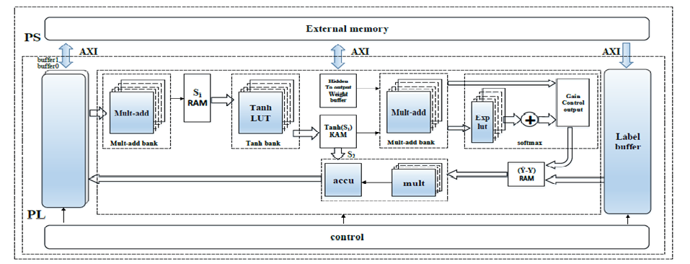
Drawbacks
Figure : A General Neural Network Hardware Architecture on FPGA
© ENGI-9819(Computer Hardware Found), 2023
www.mun.ca
Notes:
A field-programmable gate array (FPGA) is a type of integrated circuit that can be programmed or reprogrammed after manufacturing. It consists of an array of programmable logic block and interconnects that can be configured to perform various digital functions. FPGAs are commonly used in applications where flexibility, speed, and parallel processing capabilities are required, such as in telecommunications, automotive, aerospace, and industrial sectors.

